Slide 1
Do You Believe In Future Prediction

Slide 2

Future Prediction and Growth

Slide 3




Can Amazon continue to Grow

Slide 4

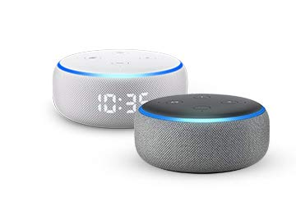
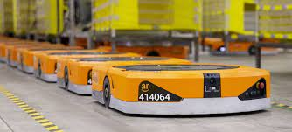
Can Amazon continue to Grow

Slide 5

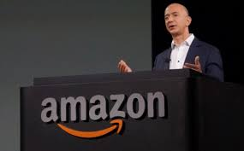

Keys for the Growth of Amazon

Slide 6

Keys for the Growth of Amazon

Slide 7
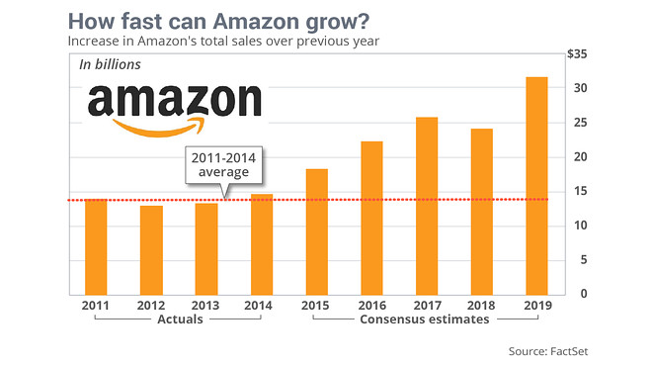
Keys for the Growth of Amazon

Slide 8
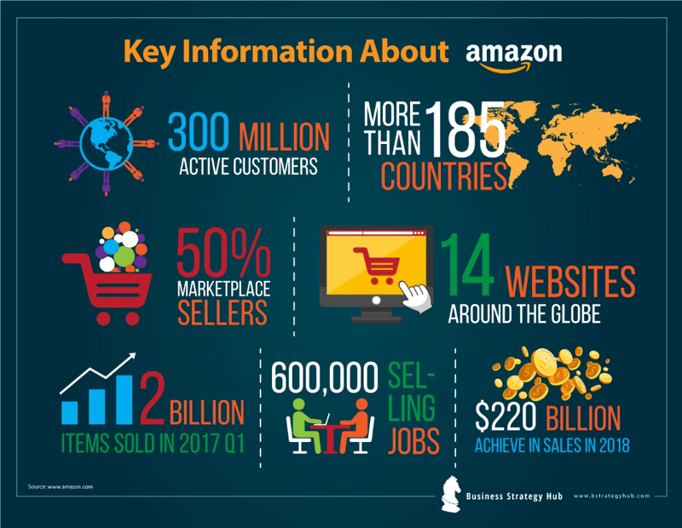
Keys for the Growth of Amazon

Slide 9
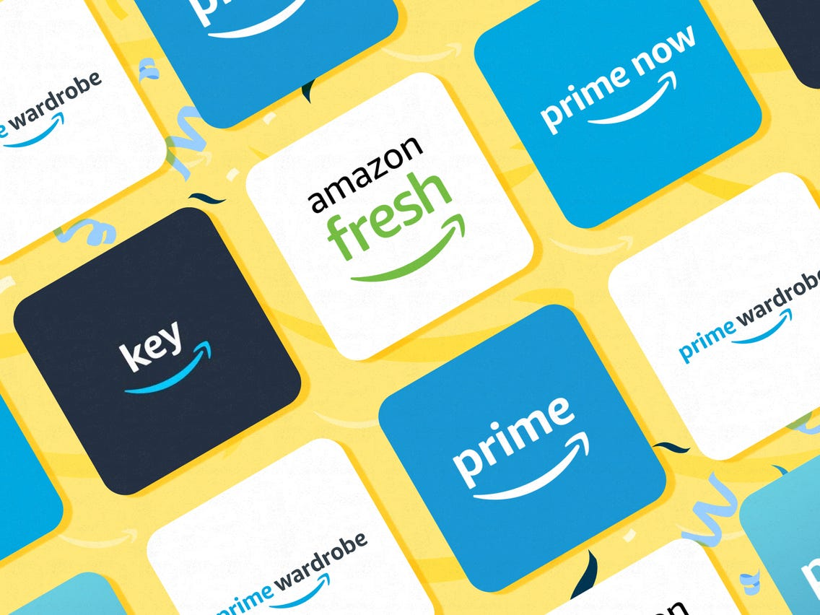
Amazon Prime Services

